Slide 1
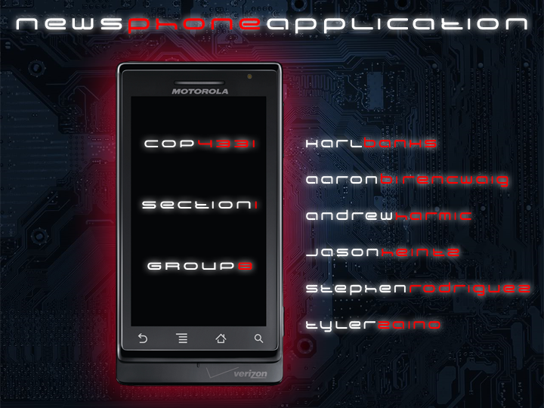

Slide 2
operational description
presented by: karl banks
The CNN NewsApp is a mobile application that delivers news directly to any Android device running the application. It retrieves news from five different sections, World, US, Money, Entertainment and Sports.

Slide 3
technical description
presented by: andrew harmic & tyler zaino
Open the application by clicking the NewsApp icon.

Slide 4
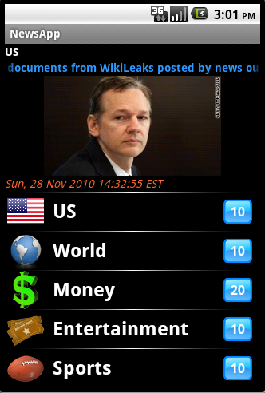
technical description
presented by: andrew harmic & tyler zaino
Once the application is fully loaded, the user is presented with the main screen. Here the user can select which subject of news they would like to read.

Slide 5
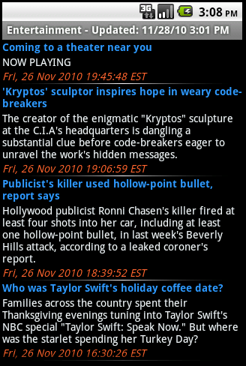
technical description
presented by: andrew harmic & tyler zaino
By clicking the subject, the user is then presented with a list of articles grabbed from the CNN website.

Slide 6
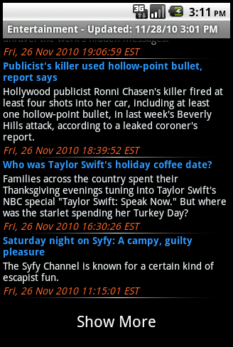
technical description
presented by: andrew harmic & tyler zaino
If the user is not satisfied with the articles presented, they are able to see more articles by scrolling to the bottom of the article list and clicking “Show More”

Slide 7
technical description
presented by: andrew harmic & tyler zaino
Once the user finds an article they are interested in, they are able to simply click the article and load it into the application.

Slide 8
technical description
presented by: andrew harmic & tyler zaino
5. The user is also presented with more options by long-clicking the article in the article list.
Open article – Simply opens the article within the application.
Open article in Browser – Opens the article within the Android devices built-in browser.
Mark as Read/Unread – Marks or unmarks the article in the article list to show if the article has been read or not.

Slide 9
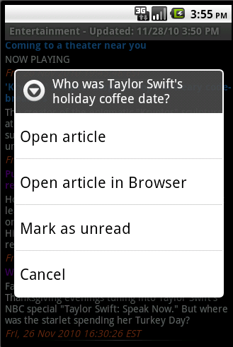
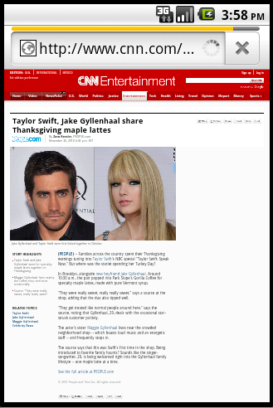
technical description
presented by: andrew harmic & tyler zaino

Slide 10
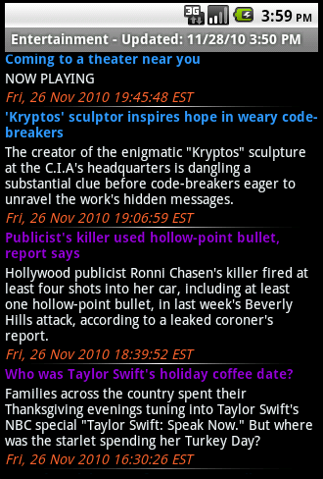
technical description
presented by: andrew harmic & tyler zaino
At any time, if the user wants to jump to another genre of news, they can simply click the Menu button on the Android device.

Slide 11
technical description
presented by: andrew harmic & tyler zaino
DEMO TIME!

Slide 12
major design issues
presented by: stephen rodriguez
At this current date, we do not have any outstanding problems with the product. All problems that were found during development and testing were taken care of immediately. There are areas in which improvement may be desired, but there are currently no know problems with the News Phone Application.

Slide 13
major design issues
presented by: stephen rodriguez
We tried to test the application under any circumstance that we could foresee the end user using the application. The testing and QA was conducted in a timely manner, but the only suggestions we have for possible improvement is to have outsiders, unfamiliar with the product, test it for effectiveness.

Slide 14
quality of the final product
presented by: aaron birencwaig
The quality of the final product is very high. The application works very well and covers all requirements and expectations, while still being user friendly. The product will work under almost any circumstances experienced by the phone except for that of catastrophic.

Slide 15
recommended usage
presented by: jason heintz
The NewsApp is targeted for those people that are always on the go and who still like to keep updated in what is happening in the news. The application can run on the latest Android phones and can be used at all times of the day. The only requirement needed by the application is an internet connection, which is either obtained through phone’s cellular signal or WiFi signal.

Slide 16
</presentation>

