Slide 2
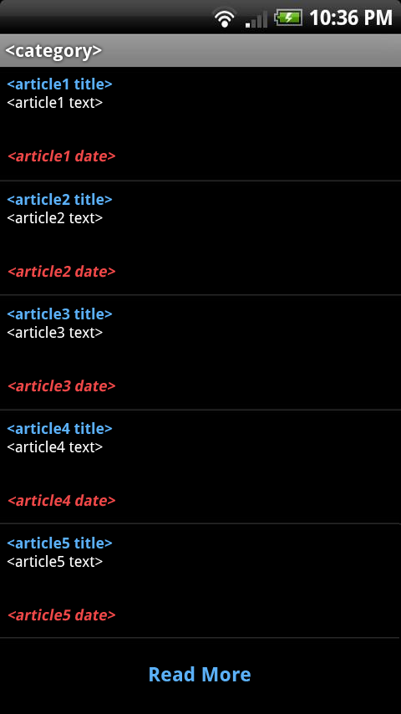
presented by: andrew harmic

Slide 3
presented by: karl banks & tyler zaino
Reusability
Maintainability
Testability
Performance
Portability
Safety/Security
Prototyping
Technical Risks

Slide 4
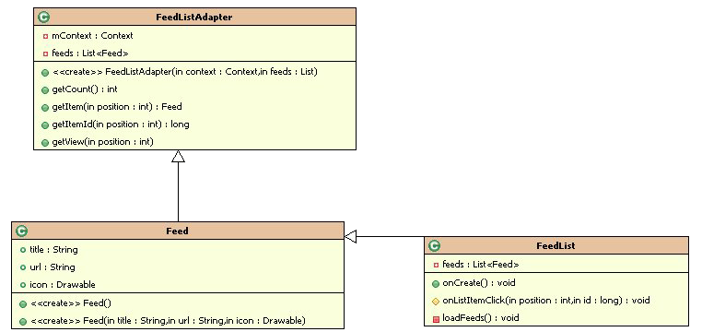
presented by: jason heintz & aaron birencwaig

Slide 5
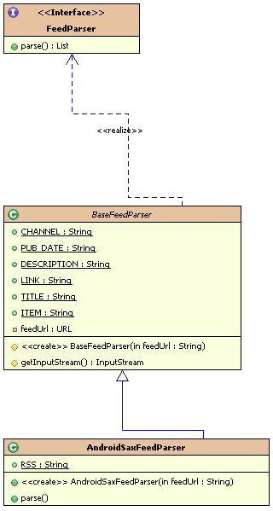
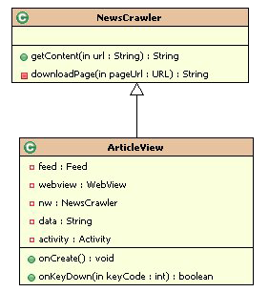
presented by: jason heintz & aaron birencwaig

Slide 6
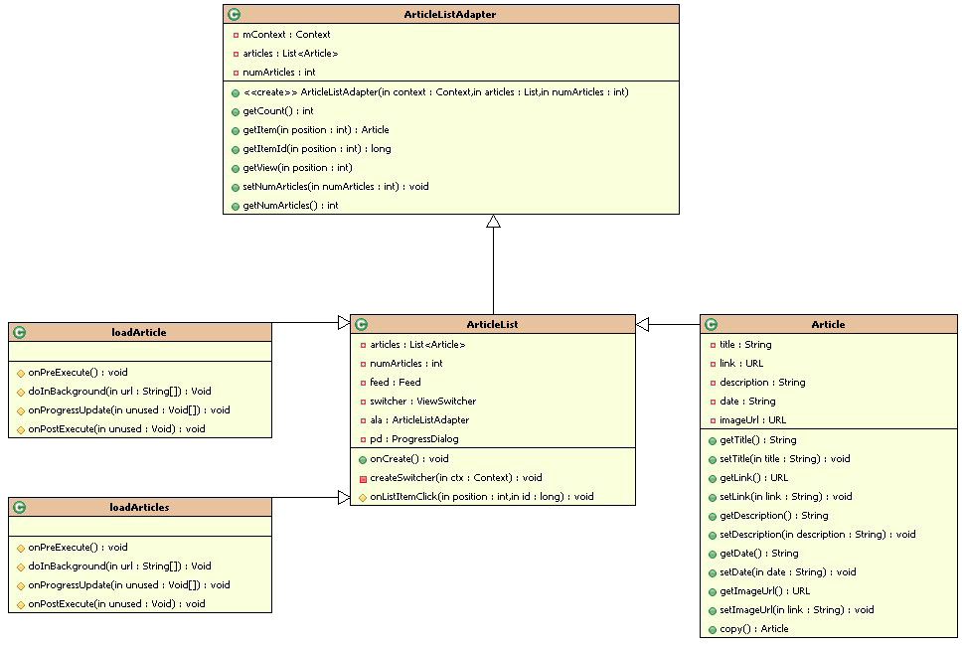
presented by: jason heintz & aaron birencwaig

Slide 7
presented by: stephen rodriguez
# | Requirement
001 | The News Phone Application shall display content on the following five areas: US, World, Money, Entertainment, and Sports
 | This is handled in multiple areas. First these sections are displayed by the drawable class for the user interface. Then the feed class gets the articles based on the type of the content.
002 | The News Phone Application shall depict a single important headline news item at its home screen.
 | This will be handled in the Article class by the getImage function.
003 | The News Phone Application shall have a drop down available that lists all news sections covered.
 | This will be handled by the drawable class that will provide the interface with all the subsections listed.

Slide 8
presented by: stephen rodriguez
# | Requirement
004 | The News Phone Application shall display, at the minimum, five news items per news section covered.
 | This will be handled in the ArticleListAdapter class by the setNumArticles and getNumArticles functions.
005 | The News Phone Application shall give the user the ability to show more news articles for each news section covered.
 | This will be handled in the ArticleListAdapter class by the setNumArticles and getNumArticles functions by changing the increasing the number of articles.
006 | The News Phone Application shall display an error message whenever the application fails to connect to the internet.
 | This will be handled in the ConnectivityManager class by the extra_no_connectivity function.
007 | The News Phone Application shall display content for every link within five seconds upon execution of that link.
 | This will be handled in the articleList class and the performance will stem from the fact the articles are coming directly from the CNN feed.

Slide 9
</presentation>

