Slide 1
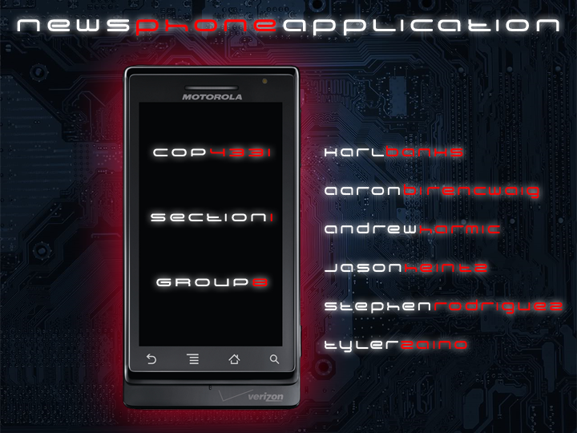

Slide 2
Karl Banks
Aaron Birencwaig
Andrew Harmic
Jason Heintz
Stephen Rodriguez
Tyler Zaino

Slide 3
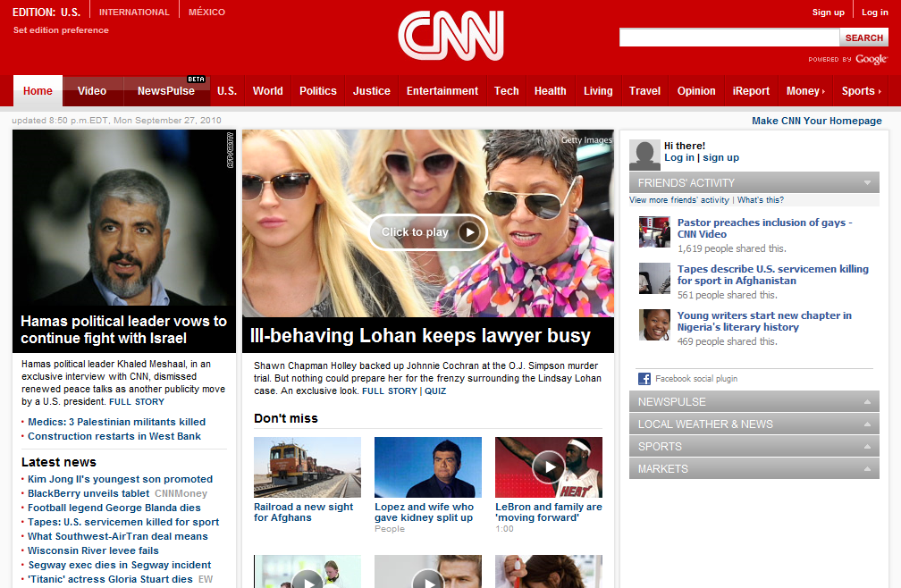
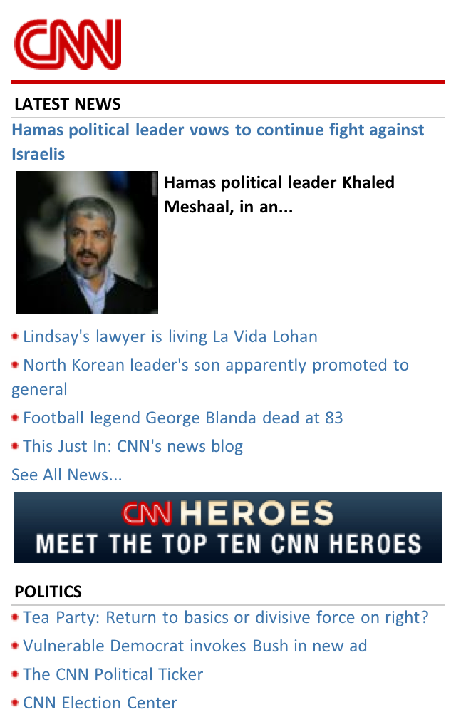
presented by: karl banks

Slide 4
presented by: tyler zaino
The Current System
The Proposed System
Needs
Users and Modes of Operation
Operational Scenarios
Operational Features
Expected Impacts
Analysis

Slide 5
presented by: andrew harmic
Project Overview
Applicable Standards
Coding Standard
Document Standard
Project Team Organization
Deliverables

Slide 6
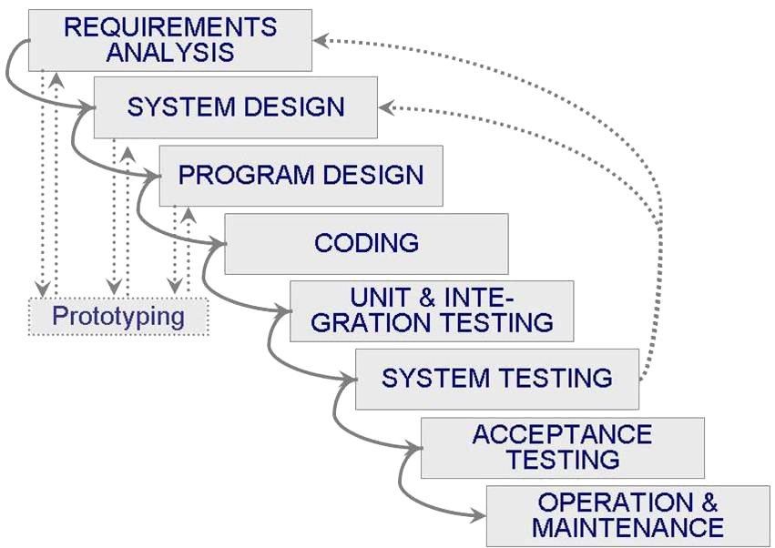
presented by: andrew harmic
Software Life Cycle Process

Slide 7
presented by: andrew harmic
Tools and Computing Environment
Windows OS
Java Programming Language
Eclipse Classic 3.5.1
Java Development Kit 6
Android Software Development Kit
Android 2.2 Platform
Android Development Tools Plug-in for Eclipse

Slide 8
presented by: andrew harmic
Configuration Management
Subversion
Quality Assurance
Risk Management
Technical Progress Metrics
Plan for Tracking, Control, and Reporting of Progress

Slide 9
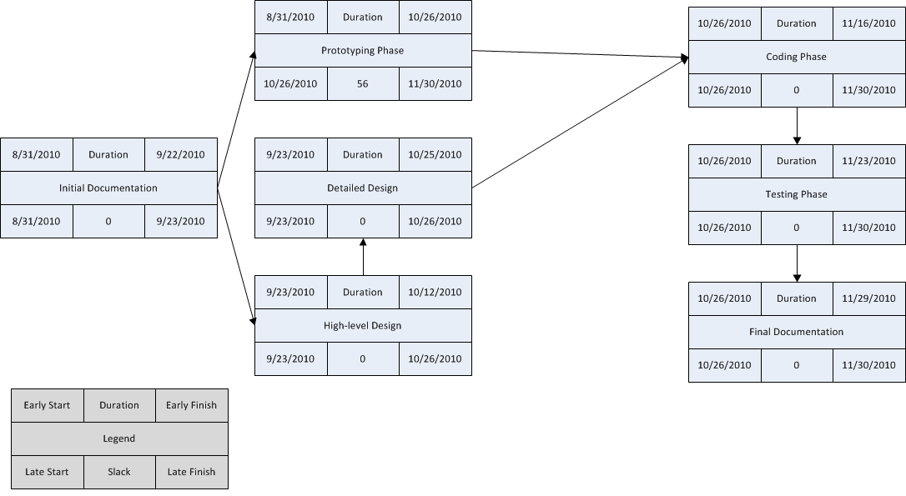
presented by: andrew harmic
PERT Chart

Slide 10
presented by: aaron birencwaig & jason heintz
Introduction - Software to be Produced
Android Based Mobile News Phone Application

Slide 11
presented by: aaron birencwaig & jason heintz
Product Overview
Assumptions
Android version 2.0, 2.1, 2.2
1 Mb of free space
Stakeholders
Developers
TA: Himanshu Pagey
Instructor: Dr. Damla Turgut

Slide 12
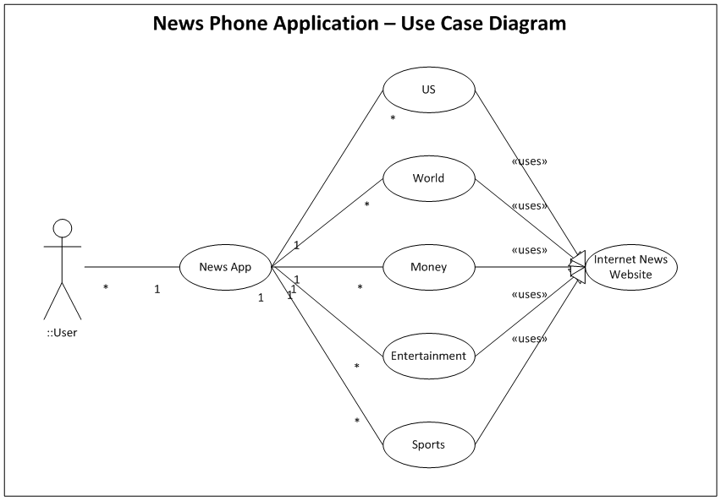
presented by: aaron birencwaig & jason heintz
Use Case Diagram

Slide 13
presented by: aaron birencwaig & jason heintz
Specific Requirements
# | Requirement
001 | The News Phone Application shall display content on the following five areas: US, World, Money, Entertainment, and Sports
002 | The News Phone Application shall depict a single important headline news item at its home screen.
003 | The News Phone Application shall have a drop down available that lists all news sections covered.
004 | The News Phone Application shall display, at the minimum, five news items per news section covered.
005 | The News Phone Application shall give the user the ability to show more news articles for each news section covered.
006 | The News Phone Application shall display an error message whenever the application fails to connect to the internet.
007 | The News Phone Application shall display content for every link within five seconds upon execution of that link.

Slide 14
presented by: aaron birencwaig & jason heintz
Event Table
Event Name | External Stimuli | External Responses | Internal data and state
Opening News Phone | Clicking on the Phone application | A single image depicting a single important headline news item, with a drop down menu. Below this should be 5 sections US, World, Money, Entertainment and Sports. | Data and picture will be gathered from the news website. It will be in the beginning News App state.
Opening drop down bar | Clicking on the drop down bar | The drop down bar will provide the user with the options to read about US, World, Money, Entertainment and Sports | This provides the user the option to transfer between states, if the user decides to read more about a certain topic.

Slide 15
presented by: aaron birencwaig & jason heintz
Event Table – cont’d
Event Name | External Stimuli | External Responses | Internal data and state
Opening news: US World Money Entertainment Sports | Clicking the news Option: US, World, Money, Entertainment, Sports. | The response would be the display of 5 items of news and then the option to show more. | This would be in the news state; the data would come from the news website. The option to show more would simply provide more articles from the same section of news.
Exit state | This is by clicking the button to leave the phone app program | The response would be exiting the News Phone Application | This is the exit state; this will simply allow the user to leave the phone News application program. The next time the phone application is opened, it will begin in the .

Slide 16
presented by: aaron birencwaig & jason heintz
Event Table – cont’d
Event Name | External Stimuli | External Responses | Internal data and state
Failed Connection | Application losses access to the internet news website | Application display an error message. | This is the failure state; the application will display a message to the user that they currently are not connected to the internet and upon reconnection the application will resume as normal.

Slide 17
presented by: aaron birencwaig & jason heintz
Functional Requirements
Ease of Use
Reliability
Interface Requirements
Android Operating System
Internet for News Sources

Slide 18
presented by: aaron birencwaig & jason heintz
Physical Environment
Android OS: 2.0, 2.1, 2.2
Java Eclipse – Android Emulator
Documentation Requirements
Intuitive
Small ReadMe File

Slide 19
presented by: aaron birencwaig & jason heintz
Data Requirements
Crawl 1 (or several) news websites
Store up to 10 articles per news section
Updated at a minimum of 5 minutes
Resource Requirements
Familiar Software
Personal Smart Phone
Android Emulator

Slide 20
presented by: aaron birencwaig & jason heintz
Security Requirements
No personal users
Internet obtainable information
No security risks
No need for backups
Quality Assurance Requirements
Uninterrupted connection to internet
Displayed error message
Available 24/7
Minimum restart time

Slide 21
presented by: stephen rodriguez
Introduction
Overall Objective for Software Test Activity
Description of Test Environment
Overall Stopping Criteria
Description of Individual Test Cases
The ability to connect to the website
The ability to switch between sections of news
The ability to select sections from the drop-down
The ability to have a “show more” button

Slide 22
</presentation>

